Slide 1


BANGGOOD REDESIGN
supervised by:
Dr.Osama Ghoniem
Eng.Omar Khaled

Slide 2
Hci project
Presented by:
1.Eman Sabry Taiel ELgamal
2.Jana Sameh Mohamed Saied
3.Mohamed Ibrahim Shalby
4.Patsy Hany Girgis Kamel
5.Wegdan Mosad Ibrahim Helal

Slide 3

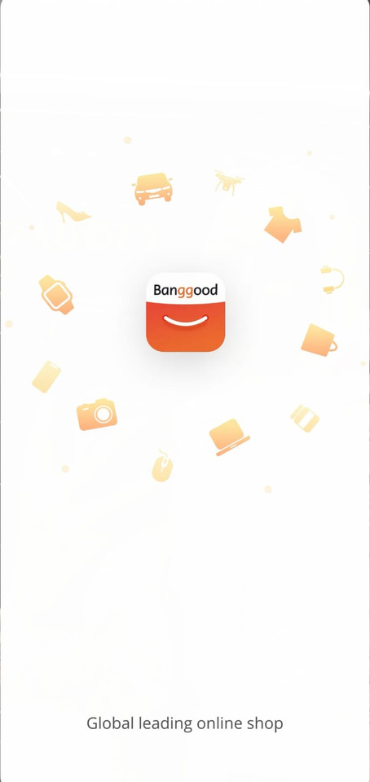
Problems in old design:
After
Before
1
1. Weak Brand Communication
No clear value proposition is presented to the user.
The slogan is generic and placed at the bottom with low visibility.
Impact:
Users do not immediately understand the app’s purpose.
2
3
4
2. Poor Visual Hierarchy
Logo, illustrations, and text compete for attention.
No clear focal point on the screen.
Elements are not arranged to guide the user’s eye.
Impact:
The screen feels visually unstructured.
5
6
7
8
3. Low Readability
Text contrast is weak.
Font size is small and placed too far from the main visual.
Impact:
Users may ignore the text completely.
9

Slide 4
Improvements in the New Design :
After
Before
1
1. Clear Brand Message
A strong headline is introduced: “Shop Smart, Live Better”.
The app’s purpose is communicated immediately.
Benefit:
Users understand what the app offers from the first second.
2
3
2. Improved Visual Hierarchy
Clear focus on the logo and brand message.
Text is placed above the logo to guide eye movement.
Benefit:
Better readability and smoother visual flow.
4
5
6
7
3. Stronger Emotional & Visual Appeal
Warm colors support brand identity.
Friendly and modern visual style.
The design feels more welcoming and trustworthy.
Benefit:
Stronger first impression and better user engagement.
8
9

Slide 5
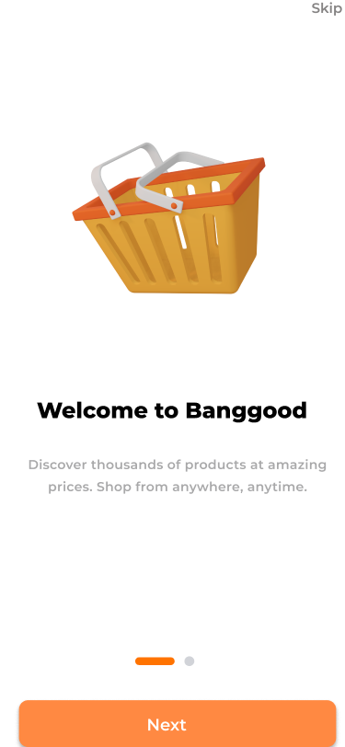
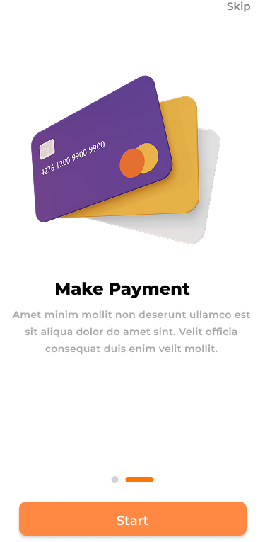
Design Improvement:
New screen
New screen
1
Adding Multiple Splash Screens
Why We Added More Splash Screens
The original design used a single splash screen with limited information.
The app’s purpose and value were not clearly communicated at launch.
New users had no guidance about what the application offers.
2
3
4
1. Clearer User Understanding
Each splash screen focuses on one key idea or feature.
Information is presented gradually instead of all at once.
2. Stronger First Impression
Splash screens help establish the app’s identity and tone.
Users immediately understand what the app is about.
3. Improved Visual Hierarchy
Content is organized into small, clear sections.
Text and visuals are balanced and easy to scan.
5
6
7
8
9

Slide 6
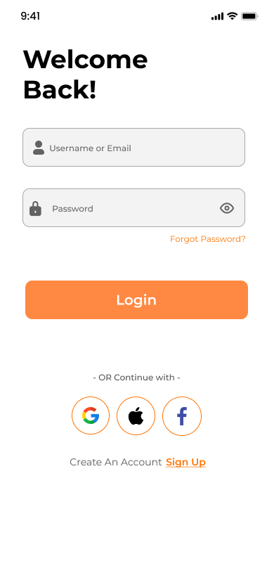
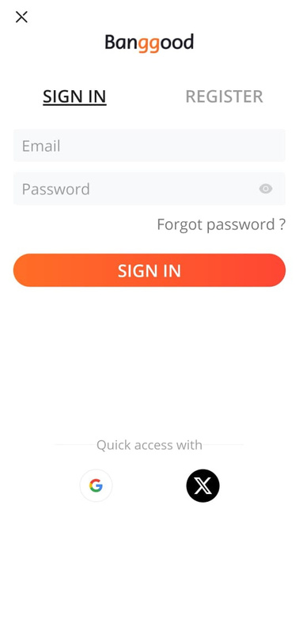
Problems in old design:
Unclear Primary Action
The “SIGN IN” button does not stand out strongly from the rest of the interface.
Users may hesitate before identifying the main action.
According to usability guidelines, primary actions should be visually dominant.
Poor Error Prevention & Guidance
No icons or visual cues inside input fields.
Users are not guided clearly on what information is required.
This reduces learnability for first-time users.
After
Before
1
2
3
4
5
3.Weak Accessibility
Low contrast between text and background in some areas.
Smaller text size for secondary actions (e.g., “Forgot password?”) makes them harder to notice.
This affects readability and accessibility compliance.
4.Less Friendly Tone
The interface feels functional but not welcoming.
Lack of a greeting or supportive language reduces user engagement
6
7
8
9

Slide 7
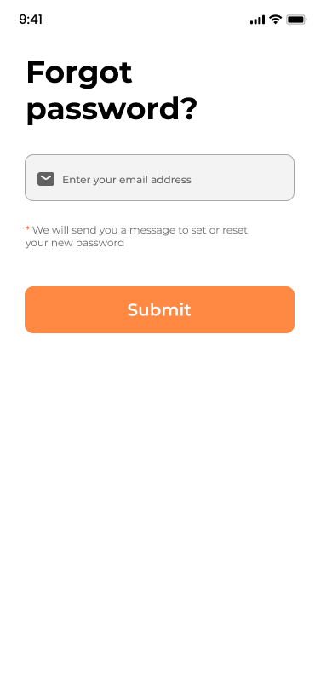
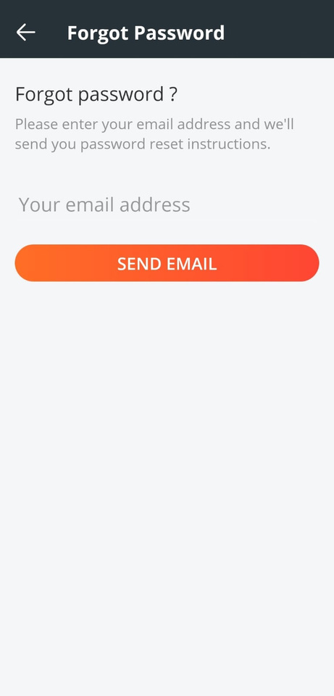
Improvements in the New Design :
Clear Primary Call to Action
The “Login” button is visually prominent using color and size.
Users instantly know what action to take next.
2. Better Learnability & Usability
Icons inside input fields help users quickly recognize field purposes.
Labels and spacing reduce ambiguity and errors.
3. Improved Accessibility
Higher color contrast and larger text improve readability.
Touch targets (buttons, social login icons) are more finger-friendly.
After
Before
1
2
3
4
5
6
4.Enhanced User Experience & Engagement
Friendly greeting (“Welcome Back!”) creates emotional connection.
Social login options are clearly grouped and labeled.
The interface feels modern, trustworthy, and user-centered.
7
8
9

Slide 8
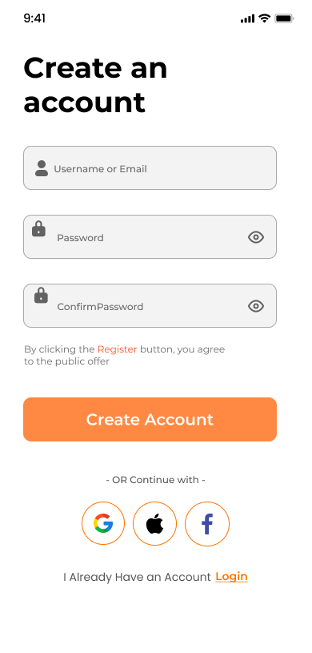
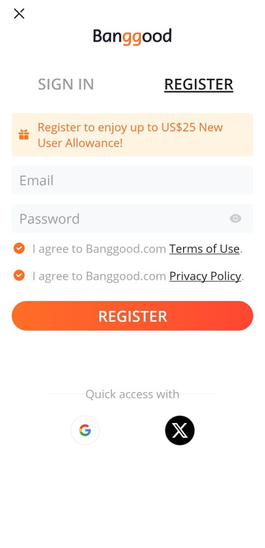
Problems in old design:
1. Unclear Primary Action
The “SIGN IN” button does not stand out clearly from other elements.
Weak visual hierarchy makes it harder for users to immediately identify the main action.
Users may hesitate before knowing where to click.
2. Poor Input Guidance
Input fields lack clear visual indicators (icons or strong placeholders).
Users are not clearly guided on what information is required in each field.
This increases the chance of input errors, especially for first-time users.
3.Weak Accessibility
Low contrast between text, background, and input borders.
Secondary actions like “Forgot password?” are small and easy to miss.
This negatively affects readability and accessibility standards.
4.Lack of Visual Feedback & Engagement
The screen feels plain and purely functional.
No welcoming message or emotional connection with the user.
The interface does not encourage confidence or comfort during login.
After
Before
1
2
3
4
5
6
7
8
9

Slide 9
Improvements in the New Design :
After
Before
1
1. Clear Primary Call to Action
The “Login” button is visually prominent using color and size.
Strong contrast immediately draws attention to the main action.
Users instantly know what to do next.
2. Better Learnability & Usability
Icons inside input fields clearly indicate email and password.
Improved spacing and alignment reduce confusion.
The layout feels more structured and intuitive.
3. Improved Accessibility
Higher color contrast improves text readability.
Larger text and buttons enhance accessibility for all users.
Touch targets are more finger-friendly on mobile devices.
4. Enhanced User Experience & Engagement
Friendly greeting (“Welcome Back!”) creates a welcoming feeling.
“Forgot password?” is more visible and easier to find.
The overall interface feels modern, trustworthy, and user-centered.
2
3
4
5
6
7
8
9

Slide 10
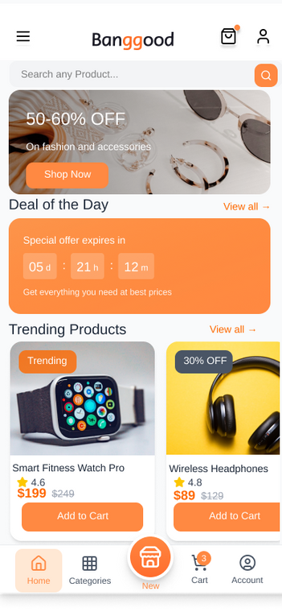
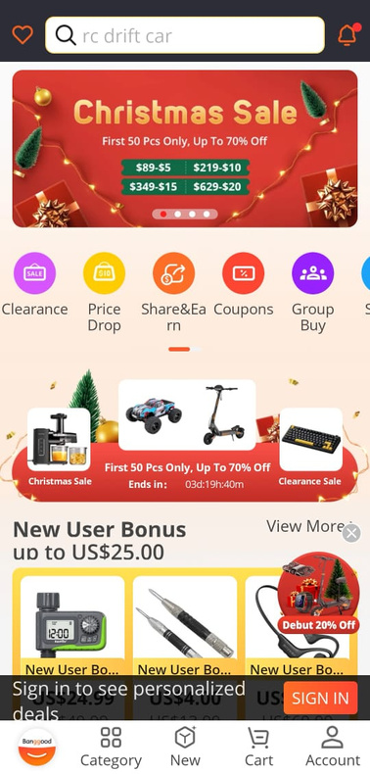
Problems in old design:
After
Before
1
Distracting and Inconsistent Color Usage
Overuse of bright colors (red, yellow, orange) across banners and labels.
Colors are used decoratively rather than functionally.
Poor Content Grouping
Deals, bonuses, categories, and products are not clearly separated.
Related items are visually mixed, making scanning difficult.
Reduced Product Discoverability
Product cards are visually small and crowded by badges and discounts.
Users may overlook key product information like price or rating.
This negatively impacts decision-making efficiency.
2
3
4
5
6
7
8
9

Slide 11
Improvements in the New Design :
Functional and Consistent Color Usage
Colors are used purposefully to highlight offers and call-to-action buttons.
Neutral background improves text readability.
Accent color guides user attention instead of overwhelming it.
Better Content Organization
Deals and products are grouped into clearly defined sections.
White space is used effectively to separate content blocks.
Improved Product Cards
Product images are larger and clearer.
Prices, discounts, and ratings are easy to identify.
“Add to Cart” buttons are clearly visible and actionable.
Enhanced User Experience
The interface feels calmer, modern, and more trustworthy.
Users can browse faster and make decisions more efficiently.
This improves overall satisfaction and task completion speed.
After
Before
1
2
3
4
5
6
7
8
9

Slide 12
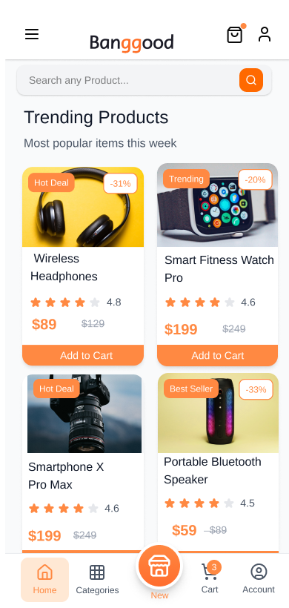
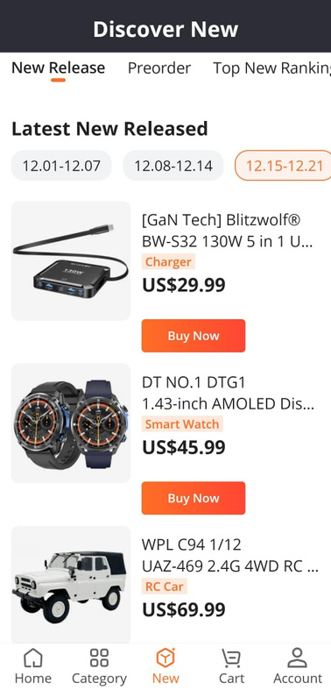
Problems in old design:
1. Poor Content Organization
Products are listed in a long vertical layout with minimal visual separation.
Lack of grouping makes it harder for users to distinguish between items.
Users need more time to scan and compare products.
2. Weak Visual Hierarchy
Product images, prices, and actions compete visually.
No clear emphasis on important elements such as ratings or prices.
Users may feel confused about where to focus first.
3. Information Overload
Too much textual information is displayed at once.
Dense layout increases cognitive load on users.
This can lead to fatigue and reduced engagement.
4. Limited Scannability
The design relies heavily on text rather than visual cues.
Users cannot quickly scan products or key details.
Browsing becomes slower and less enjoyable.
5. Outdated User Experience
The interface feels basic and less engaging.
It does not encourage exploration or interaction.
Overall experience feels less modern and less user-friendly
After
Before
1
2
3
4
5
6
7
8
9

Slide 13
Improvements in the New Design :
1. Improved Content Structure
Products are displayed in a clear card-based layout.
Visual separation helps users easily differentiate between items.
The screen feels more organized and structured.
2. Stronger Visual Hierarchy
Product images are more prominent and eye-catching.
Prices, ratings, and actions are clearly highlighted.
Users can instantly identify key information.
3. Reduced Cognitive Load
Information is simplified and better spaced.
The layout allows users to process content more comfortably.
Browsing feels smoother and less tiring.
4. Better Scannability
Card layout allows faster visual scanning.
Users can compare products quickly.
Important details are easy to spot at a glance.
5. Enhanced User Experience
The design feels modern and visually appealing.
Users are encouraged to explore more products.
Overall usability and engagement are significantly improved.
After
Before
1
2
3
4
5
6
7
8
9

Slide 14
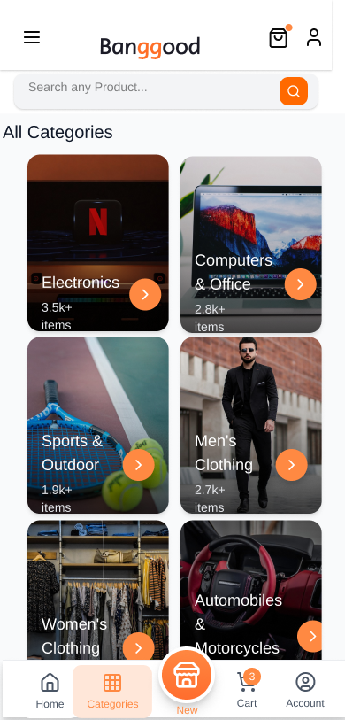
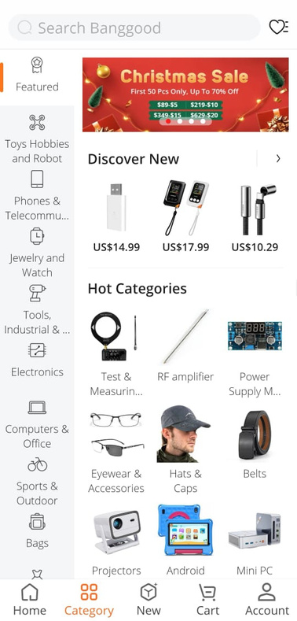
Problems in old design:
Overloaded Category Presentation
Categories are displayed as a long mixed list of icons and text.
Too many items appear at once without strong grouping.
This increases cognitive load and slows down category recognition.
Poor Scannability
The vertical list format makes it difficult to scan and compare categories quickly.
Users must read text labels instead of recognizing categories visually.
Limited Visual Affordance
Categories do not clearly indicate interactivity.
Users may not immediately understand that each item leads to a new screen.
Small and Inconsistent Touch Targets
Category icons and labels are relatively small and closely spaced.
This increases the chance of accidental taps, especially on mobile devices.
It negatively affects usability and accessibility.
After
Before
1
2
3
4
5
6
7
8
9

Slide 15
Improvements in the New Design :
Card-Based Category Layout
Categories are presented as large visual cards with images.
This supports recognition rather than recall, making categories easier to identify.
Visual representation speeds up decision making.
Improved Touch Accessibility
Larger cards create bigger touch targets.
This reduces input errors and improves mobile usability.
The design aligns with mobile accessibility guidelines.
Better Content Grouping
Categories are evenly spaced and visually grouped.
White space is used effectively to separate items.
Clear Affordance and Feedback
Arrow icons on cards clearly indicate navigation.
Users immediately understand that tapping a card leads to more content.
This improves learnability for first-time users.
After
Before
1
2
3
4
5
6
7
8
9

Slide 16
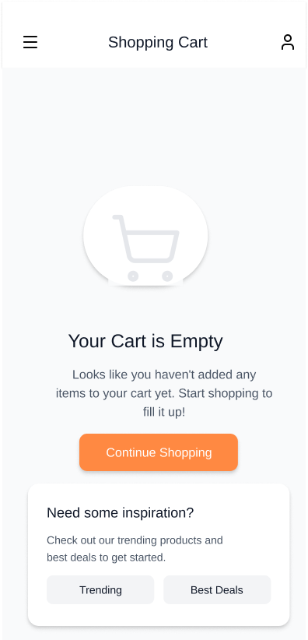
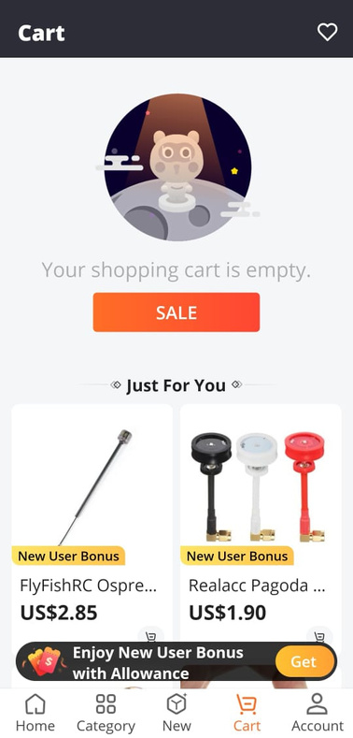
Problems in old design:
1.Distracting and Inconsistent Color Usage
Overuse of bright colors such as red, yellow, and orange across banners and promotional badges.
Colors lack clear purpose and do not reflect visual priority.
The primary CTA is visually diluted due to surrounding colorful elements.
2.Poor Content Grouping
Empty cart messaging is mixed with deals and product recommendations.
No clear visual separation between the core message (empty cart) and promotional content.
Violates Gestalt principles, especially proximity and visual hierarchy.
3.Reduced User Focus
User attention is pulled toward promotions instead of understanding the cart state.
Visual clutter negatively affects readability and comprehension.
The design does not clearly support the user’s primary task.
After
Before
1
2
3
4
5
6
7
8
9

Slide 17
Improvements in the New Design :
1.Simplified and Purposeful Color Usage
Reduced reliance on bright colors in favor of neutral tones.
Color is used intentionally to highlight the primary action (Continue Shopping).
Improved visual clarity and reduced distraction.
2.Clear Content Hierarchy
The empty cart state is clearly communicated with concise messaging.
Informational content is separated from any promotional elements.
White space is used effectively to establish visual hierarchy.
3.Improved User Guidance
Users are clearly guided toward the next logical step.
A calmer, more focused experience aligned with user intent.
Lower cognitive load and improved decision-making efficiency.
After
Before
1
2
3
4
5
6
7
8
9

Slide 18
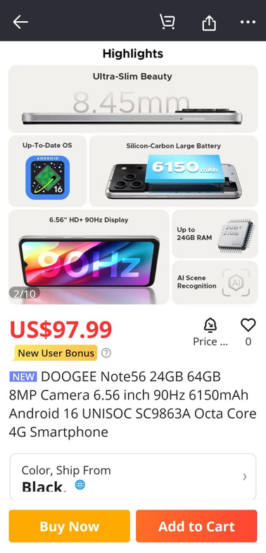
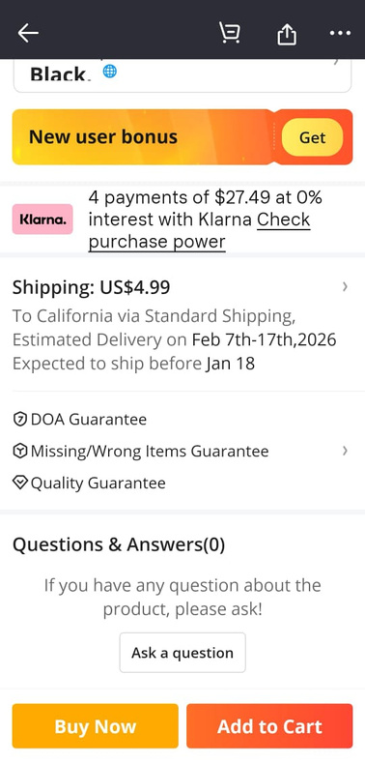
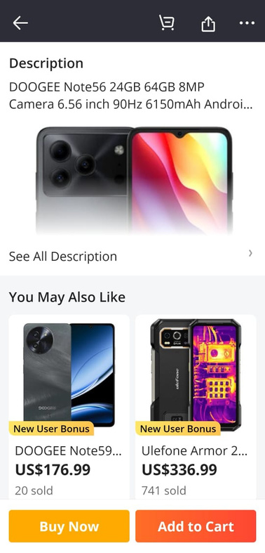
Before
10
11
12
13
14
15
16
17
18

Slide 19
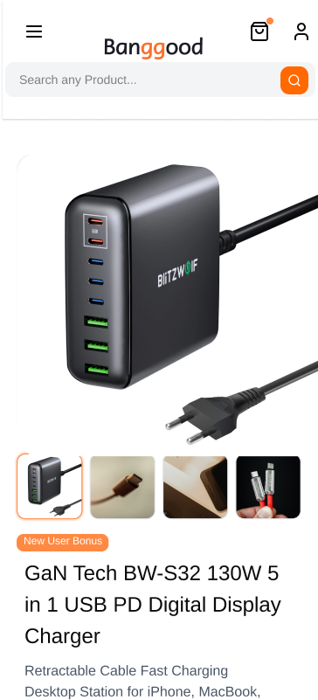
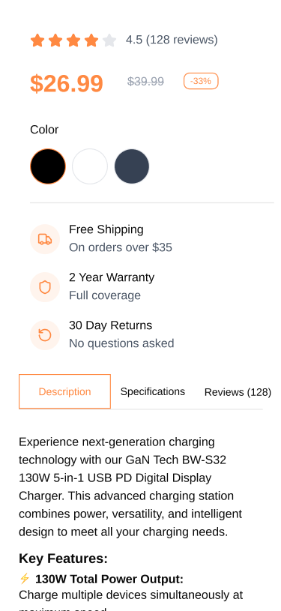
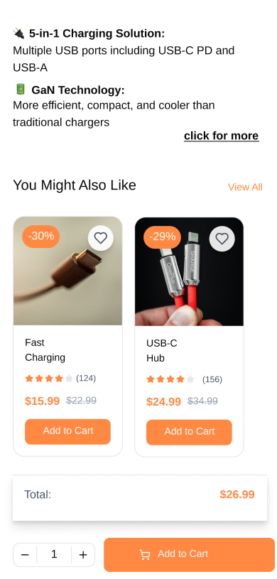
After
10
11
12
13
14
15
16
17
18

Slide 20
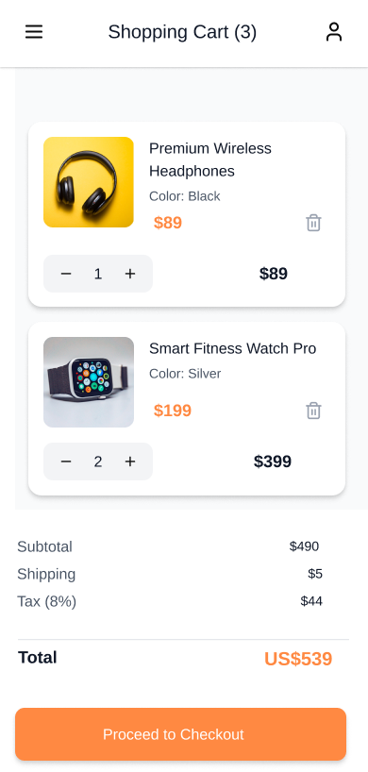
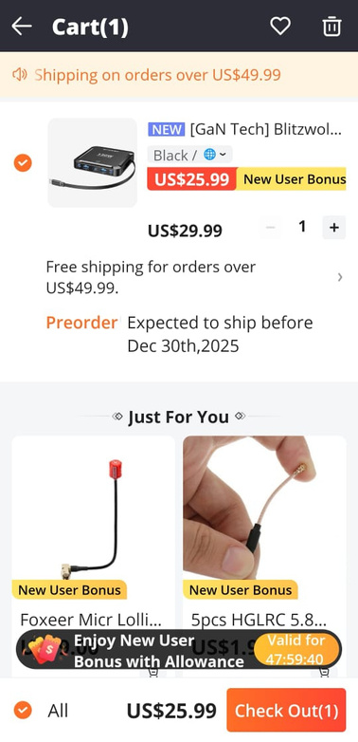
Problems in old design:
1. Visual Clutter and Distraction
Promotional banners, bonuses, and recommendations appear inside the cart.
These elements distract users from the primary goal: reviewing items and checking out.
This increases cognitive load and harms task focus.
2. Unclear Cost Breakdown
Prices, bonuses, and shipping messages are scattered across the screen.
Users must mentally calculate the final cost.
his violates the principle of *visibility of system status*.
3. Weak Visual Hierarchy
Product details, promotions, and checkout action compete for attention.
The “Check Out” button is visually mixed with other elements.
Users may hesitate before proceeding.
4. Poor Task Efficiency
Extra content (“Just For You”, bonuses) interrupts a critical flow.
This slows down checkout and may increase cart abandonment.
5. Reduced Sense of Control
The interface emphasizes promotions over user-selected items.
Users may feel pressured or confused instead of confident.
After
Before
10
11
12
13
14
15
16
17
18

Slide 21
Improvements in the New Design :
1. Focused and Minimal Layout
Only essential cart information is displayed.
No promotional distractions inside the cart.
This supports goal-oriented task completion.
2. Clear Visual Hierarchy
Product cards are clearly separated.
Quantity controls, item price, and subtotal are easy to locate.
The checkout button stands out as the primary action.
3. Transparent Cost Information
Subtotal, shipping, tax, and total price are clearly listed.
Users can immediately understand the final amount.
This improves trust and decision confidence.
4. Improved Usability and Efficiency
Users can adjust quantities or remove items easily.
The checkout process becomes faster and less error-prone.
This aligns with usability heuristics for efficiency.
5. Better User Experience
The interface feels calm, predictable, and user-centered.
Users maintain control over their purchase decisions.
This reduces friction and potential abandonment.
After
Before
10
11
12
13
14
15
16
17
18

Slide 22
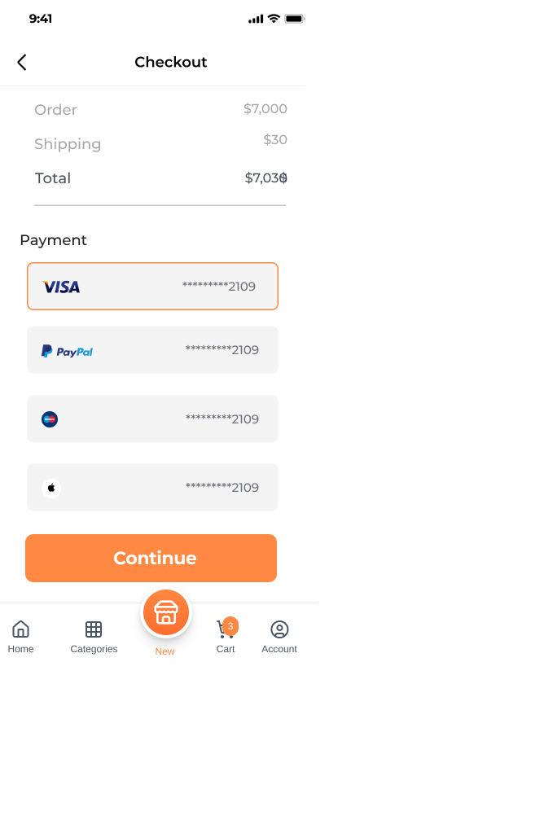
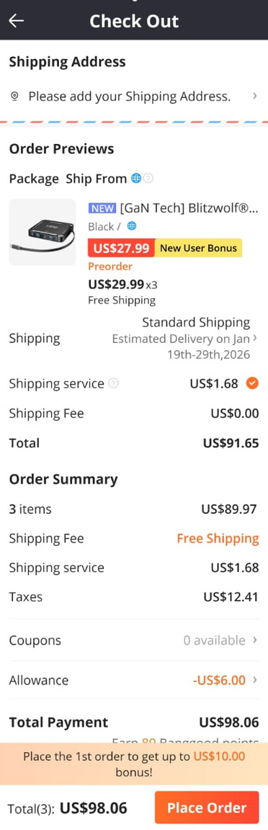
Problems in old design:
1.Distracting and Inconsistent Color Usage
Heavy use of bright colors (red, yellow, orange) for prices, bonuses, and labels.
Colors are applied decoratively rather than to indicate priority or action.
Important information competes visually, making it hard to focus on key details.
2.Poor Content Grouping
Product details, bonuses, shipping info, fees, and discounts are visually mixed.
Lack of clear separation between sections such as product summary, shipping, and total cost.
Violates Gestalt principles, particularly proximity and similarity, reducing scannability.
3.Reduced Information Clarity
Excessive labels and highlights create visual noise.
Users may struggle to quickly identify the final total or understand cost breakdowns.
Increases cognitive load during a critical decision-making step.
After
Before
10
11
12
13
14
15
16
17
18

Slide 23
Improvements in the New Design :
1.Purposeful and Consistent Color Usage
Neutral color palette with limited accent color for primary actions.
Color is used functionally to highlight the main CTA and selected payment method.
Clear visual hierarchy improves readability.
2.Clear Content Structure
Checkout information is organized into distinct sections (Order, Payment, Total).
Consistent spacing and card-based layout improve grouping and flow.
Strong alignment with Gestalt principles enhances scanning efficiency.
3.Improved Decision Confidence
Key information such as total amount and payment method is immediately visible.
Reduced visual clutter allows users to review details with confidence.
A calmer, more focused checkout experience supports conversion.
After
Before
10
11
12
13
14
15
16
17
18

Slide 24
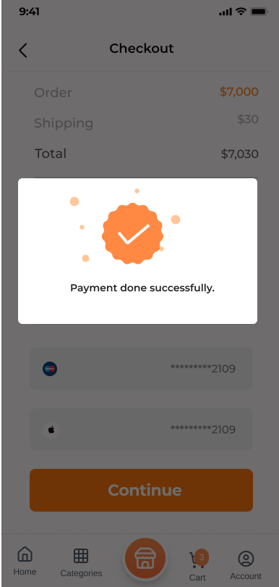
Improvements in the New Design :
Immediate System Feedback
After checkout, the user receives clear confirmation that the action was successful.
This feedback reassures users that their order has been processed.
The old design lacked explicit confirmation, leaving users uncertain about the system state.
Clear Order Status Visibility
The new design communicates the current order state (e.g., confirmed, processing).
Users no longer need to guess whether checkout was completed.
This improves visibility of system status, which was missing before.
New screen
10
11
12
13
14
15
3.Better Error Prevention
Feedback prevents users from repeating checkout actions (e.g., double payment).
Users understand that the process has ended successfully.
The old design risked repeated actions due to unclear completion feedback.
4.Enhanced User Control
Users feel in control because the system clearly responds to their action.
The interface confirms that the user’s goal has been achieved.
16
17
18

Slide 25
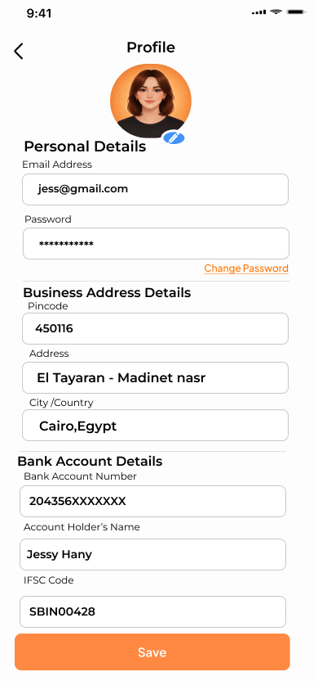
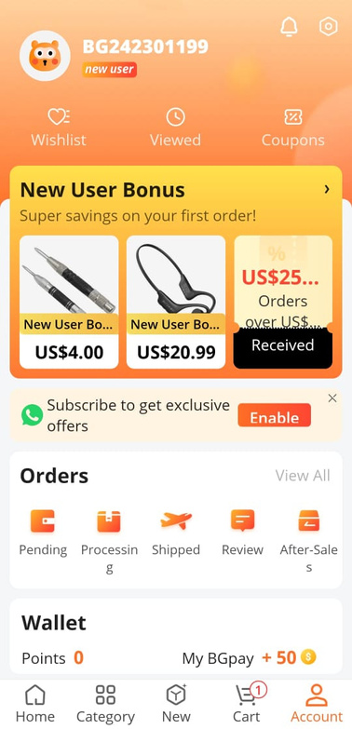
Problems in old design:
Mixed Content and Poor Focus
Personal information, promotions (New User Bonus), orders, and wallet details are shown on the same screen.
This creates distraction and makes it difficult to focus on profile-related tasks.
The interface does not support goal-oriented interaction.
Lack of Editable Personal Information
Users cannot clearly view or edit personal, address, or payment details.
This limits user control over their own data.
The old design does not support flexibility or personalization.
Weak Information Organization
Profile-related data is not structured into logical sections.
Users must scan through irrelevant content (ads, bonuses) to find account information.
This reduces efficiency and increases cognitive load.
After
Before
10
11
12
13
14
15
16
17
18

Slide 26
Improvements in the New Design :
Dedicated Profile Management
The new design provides a clear “Profile” screen focused only on user information.
Personal details, address details, and bank details are separated into clear sections.
This improves clarity and task efficiency.
Editable User Information
Users can directly edit:
Personal details
Business address
Bank account information
This increases user control and freedom, which was missing before.
After
Before
10
11
12
13
14
15
16
3.Security and Account Control Features
Options such as “Change Password” are clearly visible.
This improves perceived security and trust.
4.Minimal and Distraction-Free Interface
Promotional banners are removed from the profile screen.
The interface focuses solely on account management tasks.
17
18

Slide 27

10
11
12
Thank you
13
14
15
16
17
18

